Slide 1
Advanced Programming
CSE 201
Instructor: Sambuddho
(Semester: Monsoon 2024)
Week 10 – File Streams and I/O Operations

Slide 2
Reading and Writing to files.
Input stream: Used to read sequence of bytes (could be anything ``representable’’ as a file).
Output stream: Used to write sequence of bytes (could be anything ``representable’’ as a file).

Slide 3
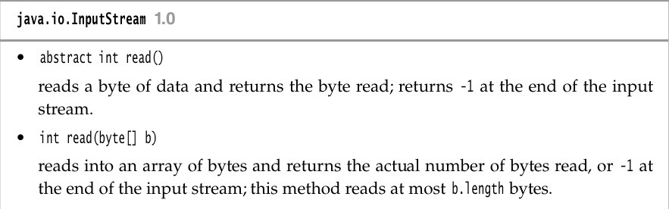
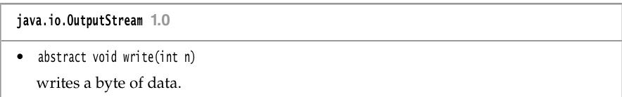
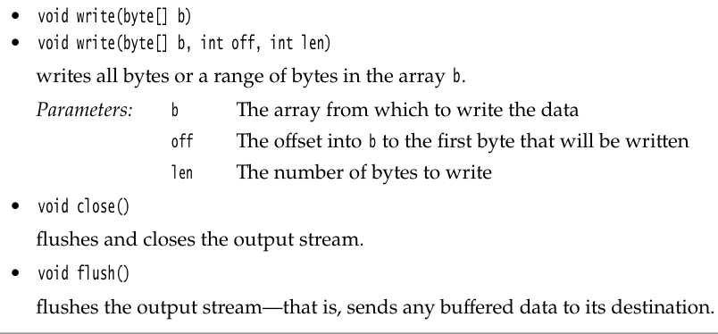
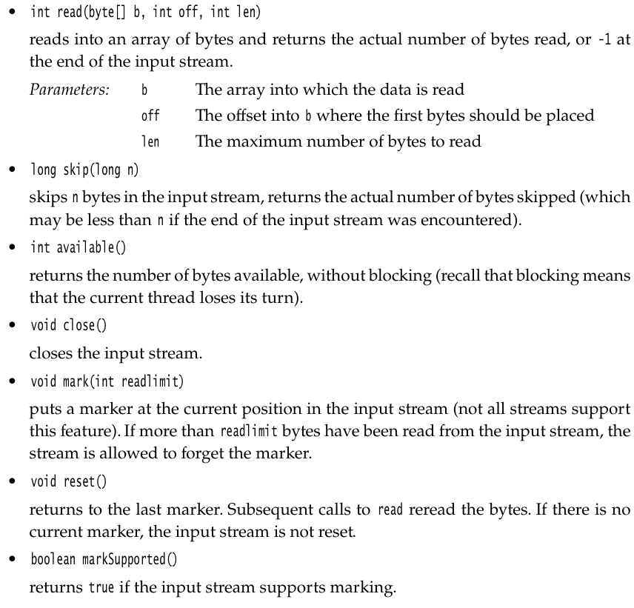
Reading and Writing to files.
InputStream : abstract int read()
[ Return values: -1 if error, or the byte read (upcasted to an int {4-bytes}). ]
OutputStream : abstract void write(int b)
[ Write a single byte (upcasted as an int). ]S

Slide 4
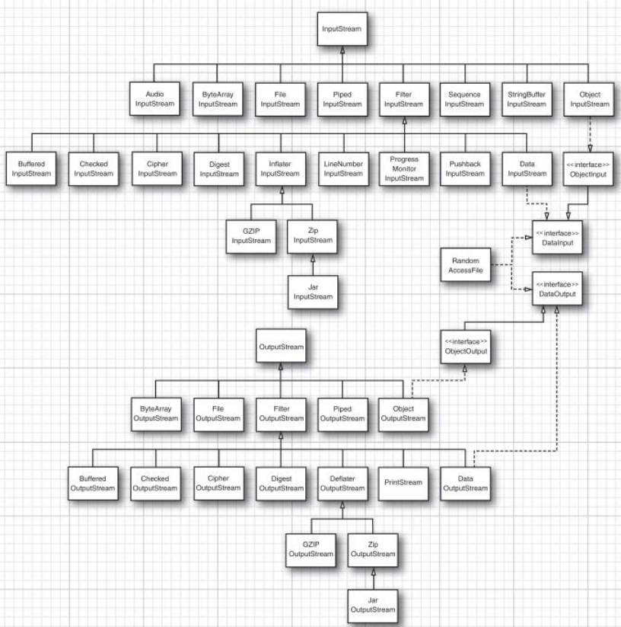
I/O Stream (plus Reader/Writer) Hierarchy

Slide 5
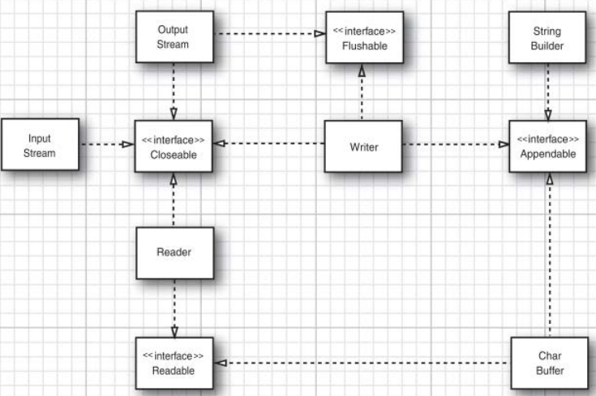
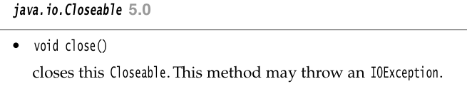
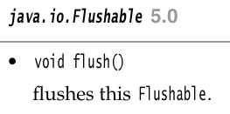
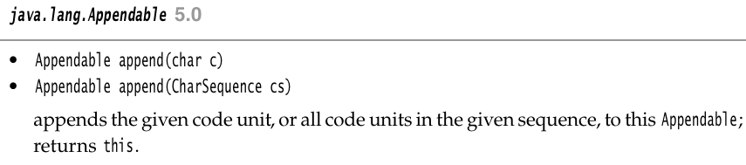
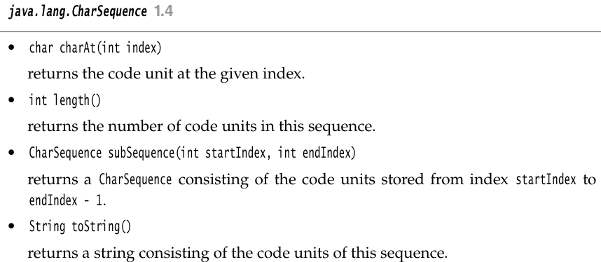
I/O Stream (plus Reader/Writer) Hierarchy

Slide 6



Reading Writing from Files
FileInputStream – Read bytes from file.
FileOutputStream – Write bytes to file

Slide 7

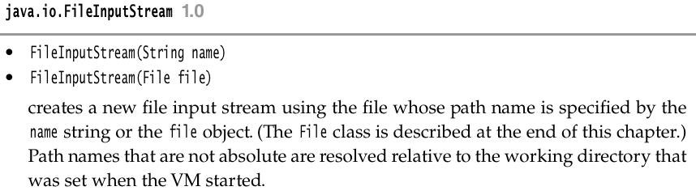

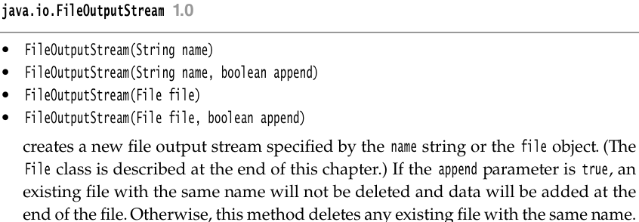
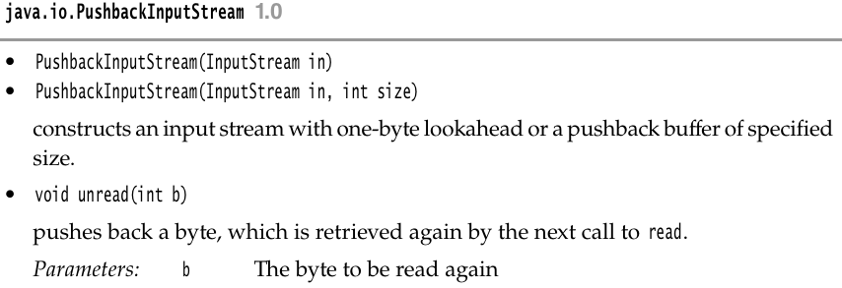
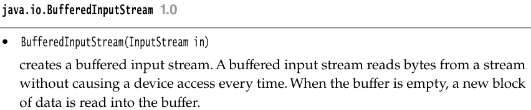
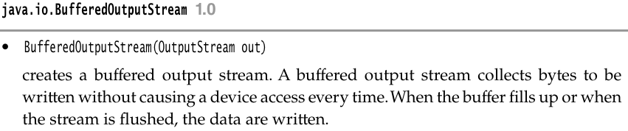
Reading Writing from Files -- PushbackInputStream

Slide 8
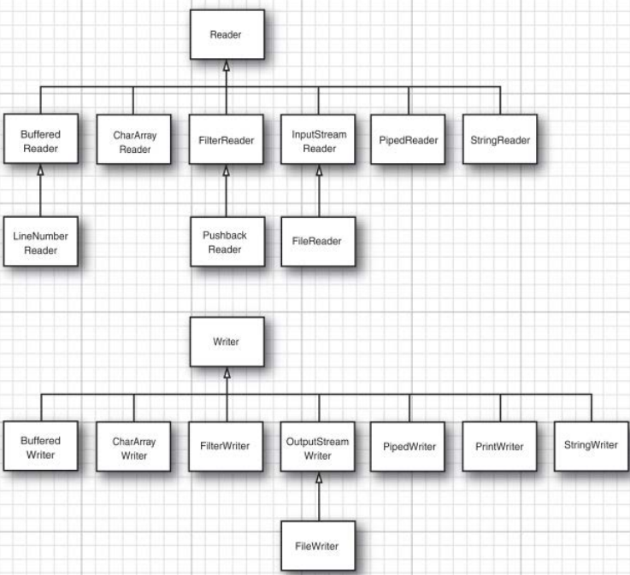
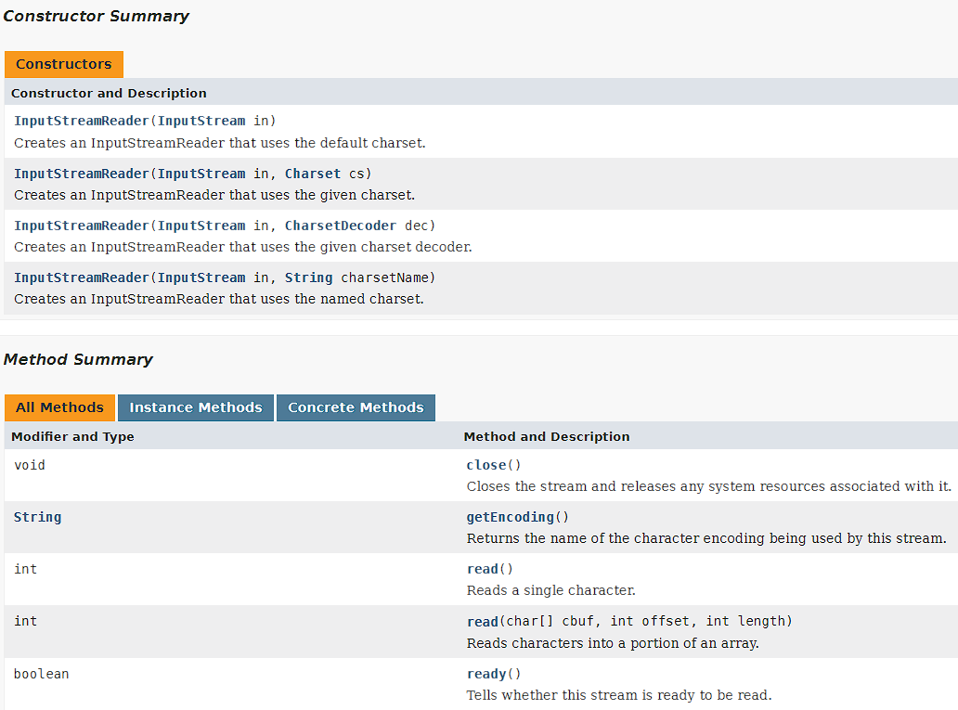
Text I/O – Reader/Writer
char b = (char) in.read();

Slide 9
Text I/O – Buffered Reader
Reader br = new BufferedReader(new BufferedInputStream(new InputStreamReader(“myfile”)));
String next_str = br.readline(); // Read an entire line.
char next_char = br.read(); // read single character.
List<String> lines = Files.readAllLines(path, charset); // read multiple lines as strings for file path.
Alternative way to read lines of a file without the List<>.
InputStream inputStream = . . .;
try (BufferedReader in = new BufferedReader(new InputStreamReader(inputStream,
StandardCharsets.UTF_8)))
{
String line;
while ((line = in.readLine()) != null)
{
do something with line
}
}

Slide 10

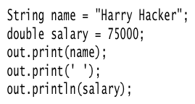

Text I/O – File Writer

Slide 11
Reading and Writing Binary Data
DataInput and DataOutput interfaces:
readChars(), readByte(), readInt(), readShort(), readLong(), readFloat(), readDouble(), readChar(), readBoolean(), readUTF().
writeChars(), writeByte(), writeInt(), writeShort(), writeLong(), writeFloat(), writeDouble(), writeChar(), writeBoolean(), writeUTF().
Using DataInputStream and DataOutputStream:
DataInputStream in = new DataInputStream(new FileInputStream("employee.dat"));
DataOutputStream out = new DataOutputStream(new FileOutputStream("employee.dat"));

Slide 12
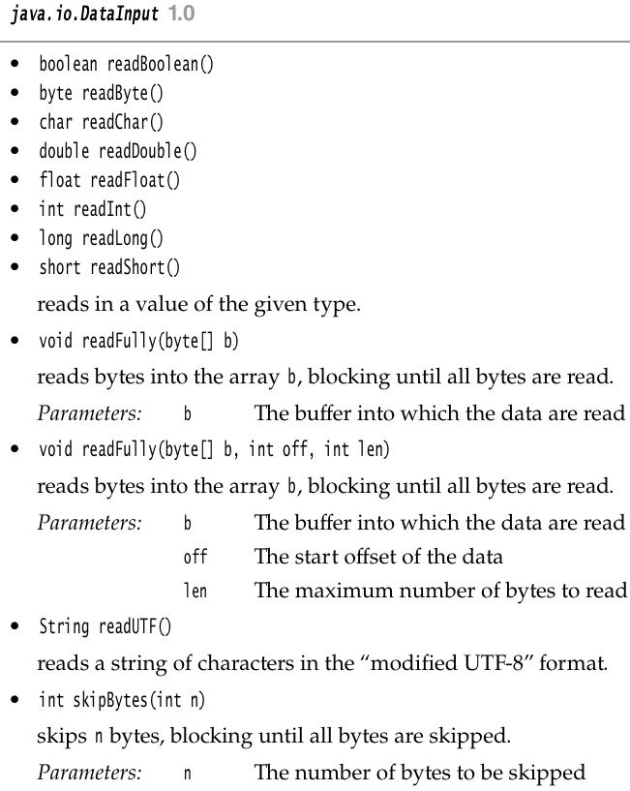
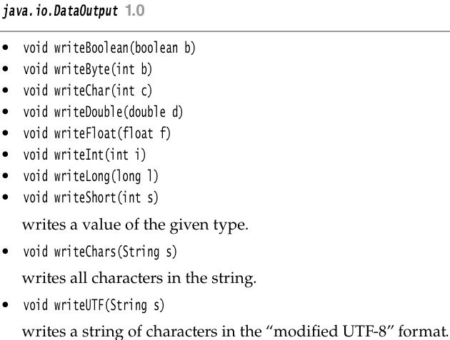
Reading and Writing Binary Data

Slide 13

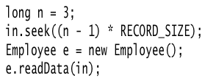

Random Access Files
- Files are sequential access.
- Random access files can help access at any location (seek at random locations) – has a ``file pointer’’ much like C/C++.
- RandomAccessFile implements both DataInput and DataOutput interfaces – use methods like readInt()/writeInt() etc.

Slide 14
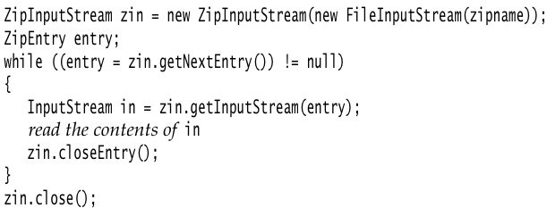
Zip Archive Files
- Used for accessing compressed (.zip) files.
- ZipInputStream class to read a .zip file.
- ZipOutputStream class to write to a .zip file.
- Compressed file stream stored in blocks, aka ``entires’’.

Slide 15
Zip Archive Files
Writing to a ZIP file – use ZipOutputStream class.
FileOutputStream fout = new FileOutputStream("test.zip");
ZipOutputStream zout = new ZipOutputStream(fout);
for all files
{
ZipEntry ze = new ZipEntry(filename);
zout.putNextEntry(ze);
zout.write(...);
zout.closeEntry();
}
zout.close();

Slide 16

Path Interface and Files Class
Used to work with the file system for operations like create file, delete file, create directory etc.
Paths – Sequence of directory names, optionally followed by a file name. The first component is the root [e.g. / or C:\ ].
(Throws InvalidPathException if it is not a valid path)

Slide 17


Path Interface and Files Class
Read path as a string from a config file.
Path resolution:
To resolve a path, e.g. to find the working directory relative to a known path:
OR

Slide 18
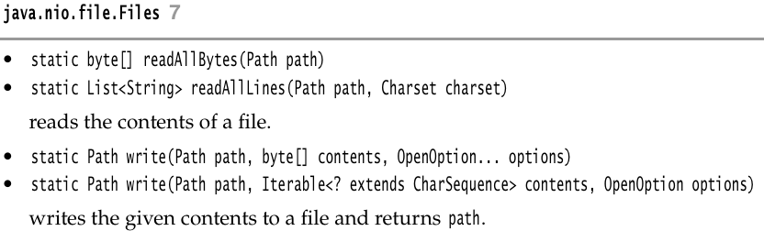
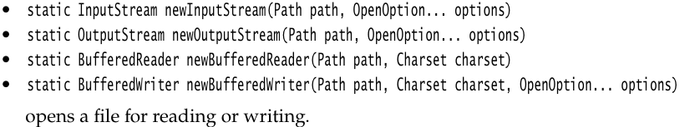


Reading Files
Read bytes from a file into a byte array.
Read all lines are a collection of strings.
Write bytes to a file.
Write bytes to a file.
Reading large files:

Slide 19
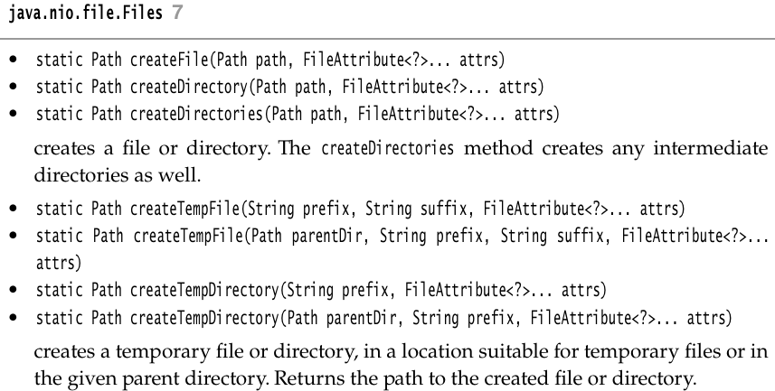



Directories
Creating directory from path.
Creating intermediate directories.
Creating intermediate directories.
Creating and empty file in a directory.
Creating temporary files and directories in
system-specific locations.

Slide 20
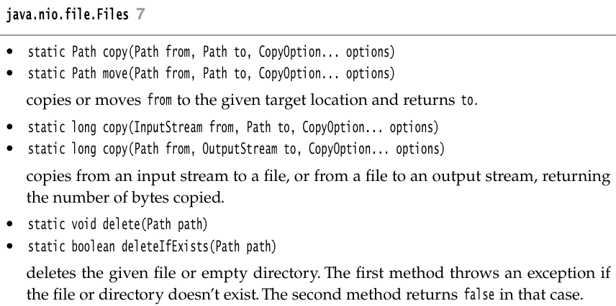


Copying, Moving and Deleting Files
Copy file from one location to another.
Move/rename
Copy/move with target overwrite:
Atomic move (move correctly or don’t remove sources):
Copy files from InputStream to path and from
Path to OutputStream
Delete file

Slide 21
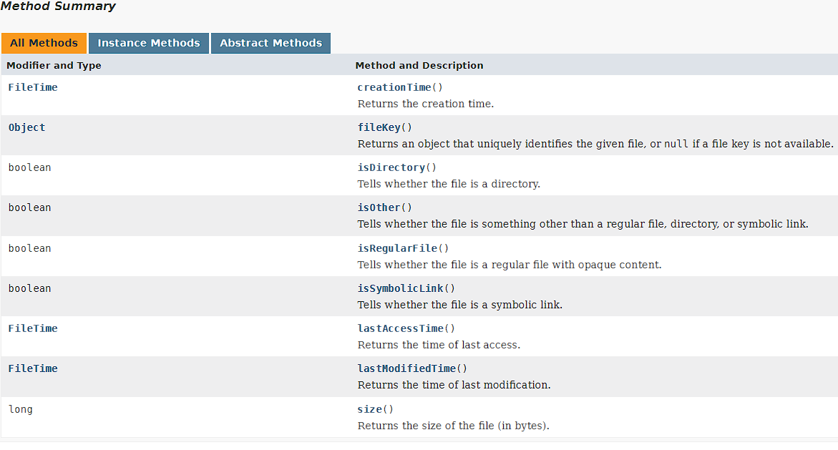
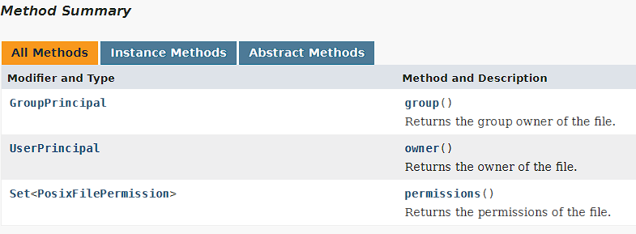
Getting File Attributes
All FS attributes are encapsulated in the BasicFileAttributes and PosixFileAttributes

Slide 22



Directory Traversal/Walk
Filtering files in a directory
Directories are also files, so you can read all the entries of a directory and use them.
Using directory streams.

Slide 23
Memory Mapped I/O
- Instead of writing and reading from disk directly, map the file to a memory location and work on it like its a flat memory.
(Caveat: In reality all files are mapped to a location of memory for faster operation, aka BufferedReader).
Steps:
1. Get a FileChannel object of a file (like a file handle).
2. Specify the file area you want to map, using the FileChannel (1) and the mapping mode (FileChannel.MapMode.READ_ONLY,FileChannel.MapMode.READ_WRITE,FileChannel.MapMode.Private).
3. (2) provides a reference to ByteBuffer class that can be used for reading and writing like a flat file.
Buffers can be both sequential (using the get() and put() method that advance the position) or random-access using the actual location.

Slide 24
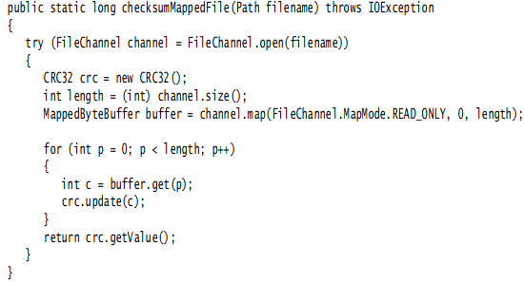


Memory Mapped I/O
Sequential access
Random access

Slide 25
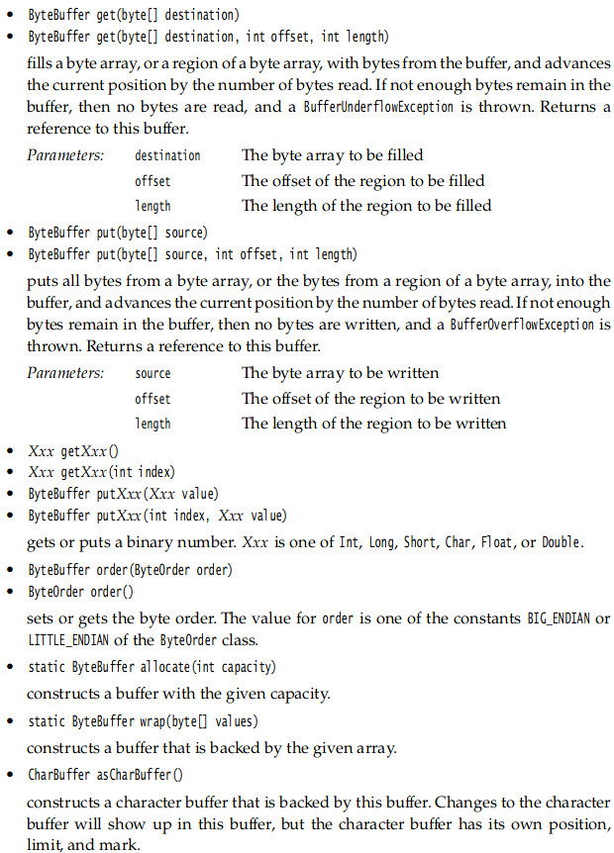
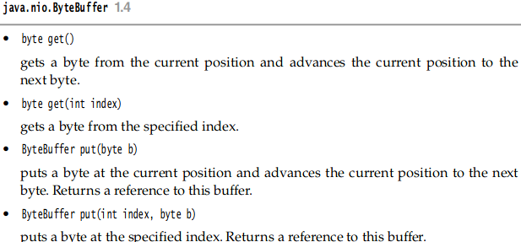
Memory Mapped I/O

